Slide 1
Java Swing
Prepared by: Lec Tasmiah Tamzid Anannya, CSE Dept, MIST

Slide 2
What is GUI in Java?
GUI (Graphical User Interface) In Java gives programmers an easy-to-use visual experience to build Java applications.
Mainly made of graphical components like buttons, tables, textfields, labels, windows, etc. through which the user can interact with the applications.
Swing GUI in Java plays an important role in building easy interfaces.

Slide 3
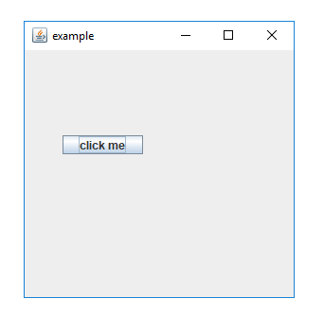
GUI Example

Slide 4
What is Swing in Java?
Swing in Java is a Graphical User Interface (GUI) toolkit that includes a rich set of widgets.
It is a part of Java Foundation Classes(JFC), which is an API for Java programs that provide GUI.
The Swing library is built on top of the Java Abstract Widget Toolkit (AWT), an older, platform dependent GUI toolkit.
Supports MVC architecture
Model represents component's data.
View represents visual representation of the component's data.
Controller takes the input from the user on the view and reflects the changes in Component's data.

Slide 5
Difference between AWT and Swing
AWT | SWING
Platform Dependent | Platform Independent
Does not follow MVC | Follows MVC
Lesser Components | More powerful components
Does not support pluggable look and feel | Supports pluggable look and feel
Heavyweight | Lightweight

Slide 6
Container and Component
Any class which has other components in it is called as a container class. For building GUI applications at least one container class is necessary.
Following are the three types of container classes:
Panel – It is used to organize components on to a window
Frame – A fully functioning window with icons and titles
Dialog – It is like a pop up window but not fully functional like the frame
Components:
Jbutton, Jtextfield, JPasswordField, Jscrollbar etc..

Slide 7
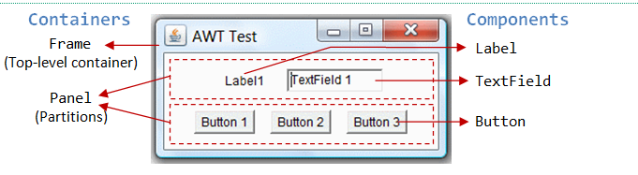
Container and Component

Slide 8
Event Handling-What is an Event?
Change in the state of an object is known as Event.
Events are generated as a result of user interaction with the graphical user interface components.
For example, clicking on a button, moving the mouse, entering a character through keyboard, selecting an item from the list, and scrolling the page are the activities that causes an event to occur.

Slide 9
How events are handled?
Event Handling is the mechanism that controls the event and decides what should happen if an event occurs.
This mechanism has a code which is known as an event handler, that is executed when an event occurs.
Source
The source is an object on which the event occurs.
Source is responsible for providing information of the occurred event to it's handler.
Java provide us with classes for the source object.
Listener −
It is also known as event handler.
The listener is responsible for generating a response to an event.
From the point of view of Java implementation, the listener is also an object. The listener waits till it receives an event.
Once the event is received, the listener processes the event and then returns.

